Slide 1
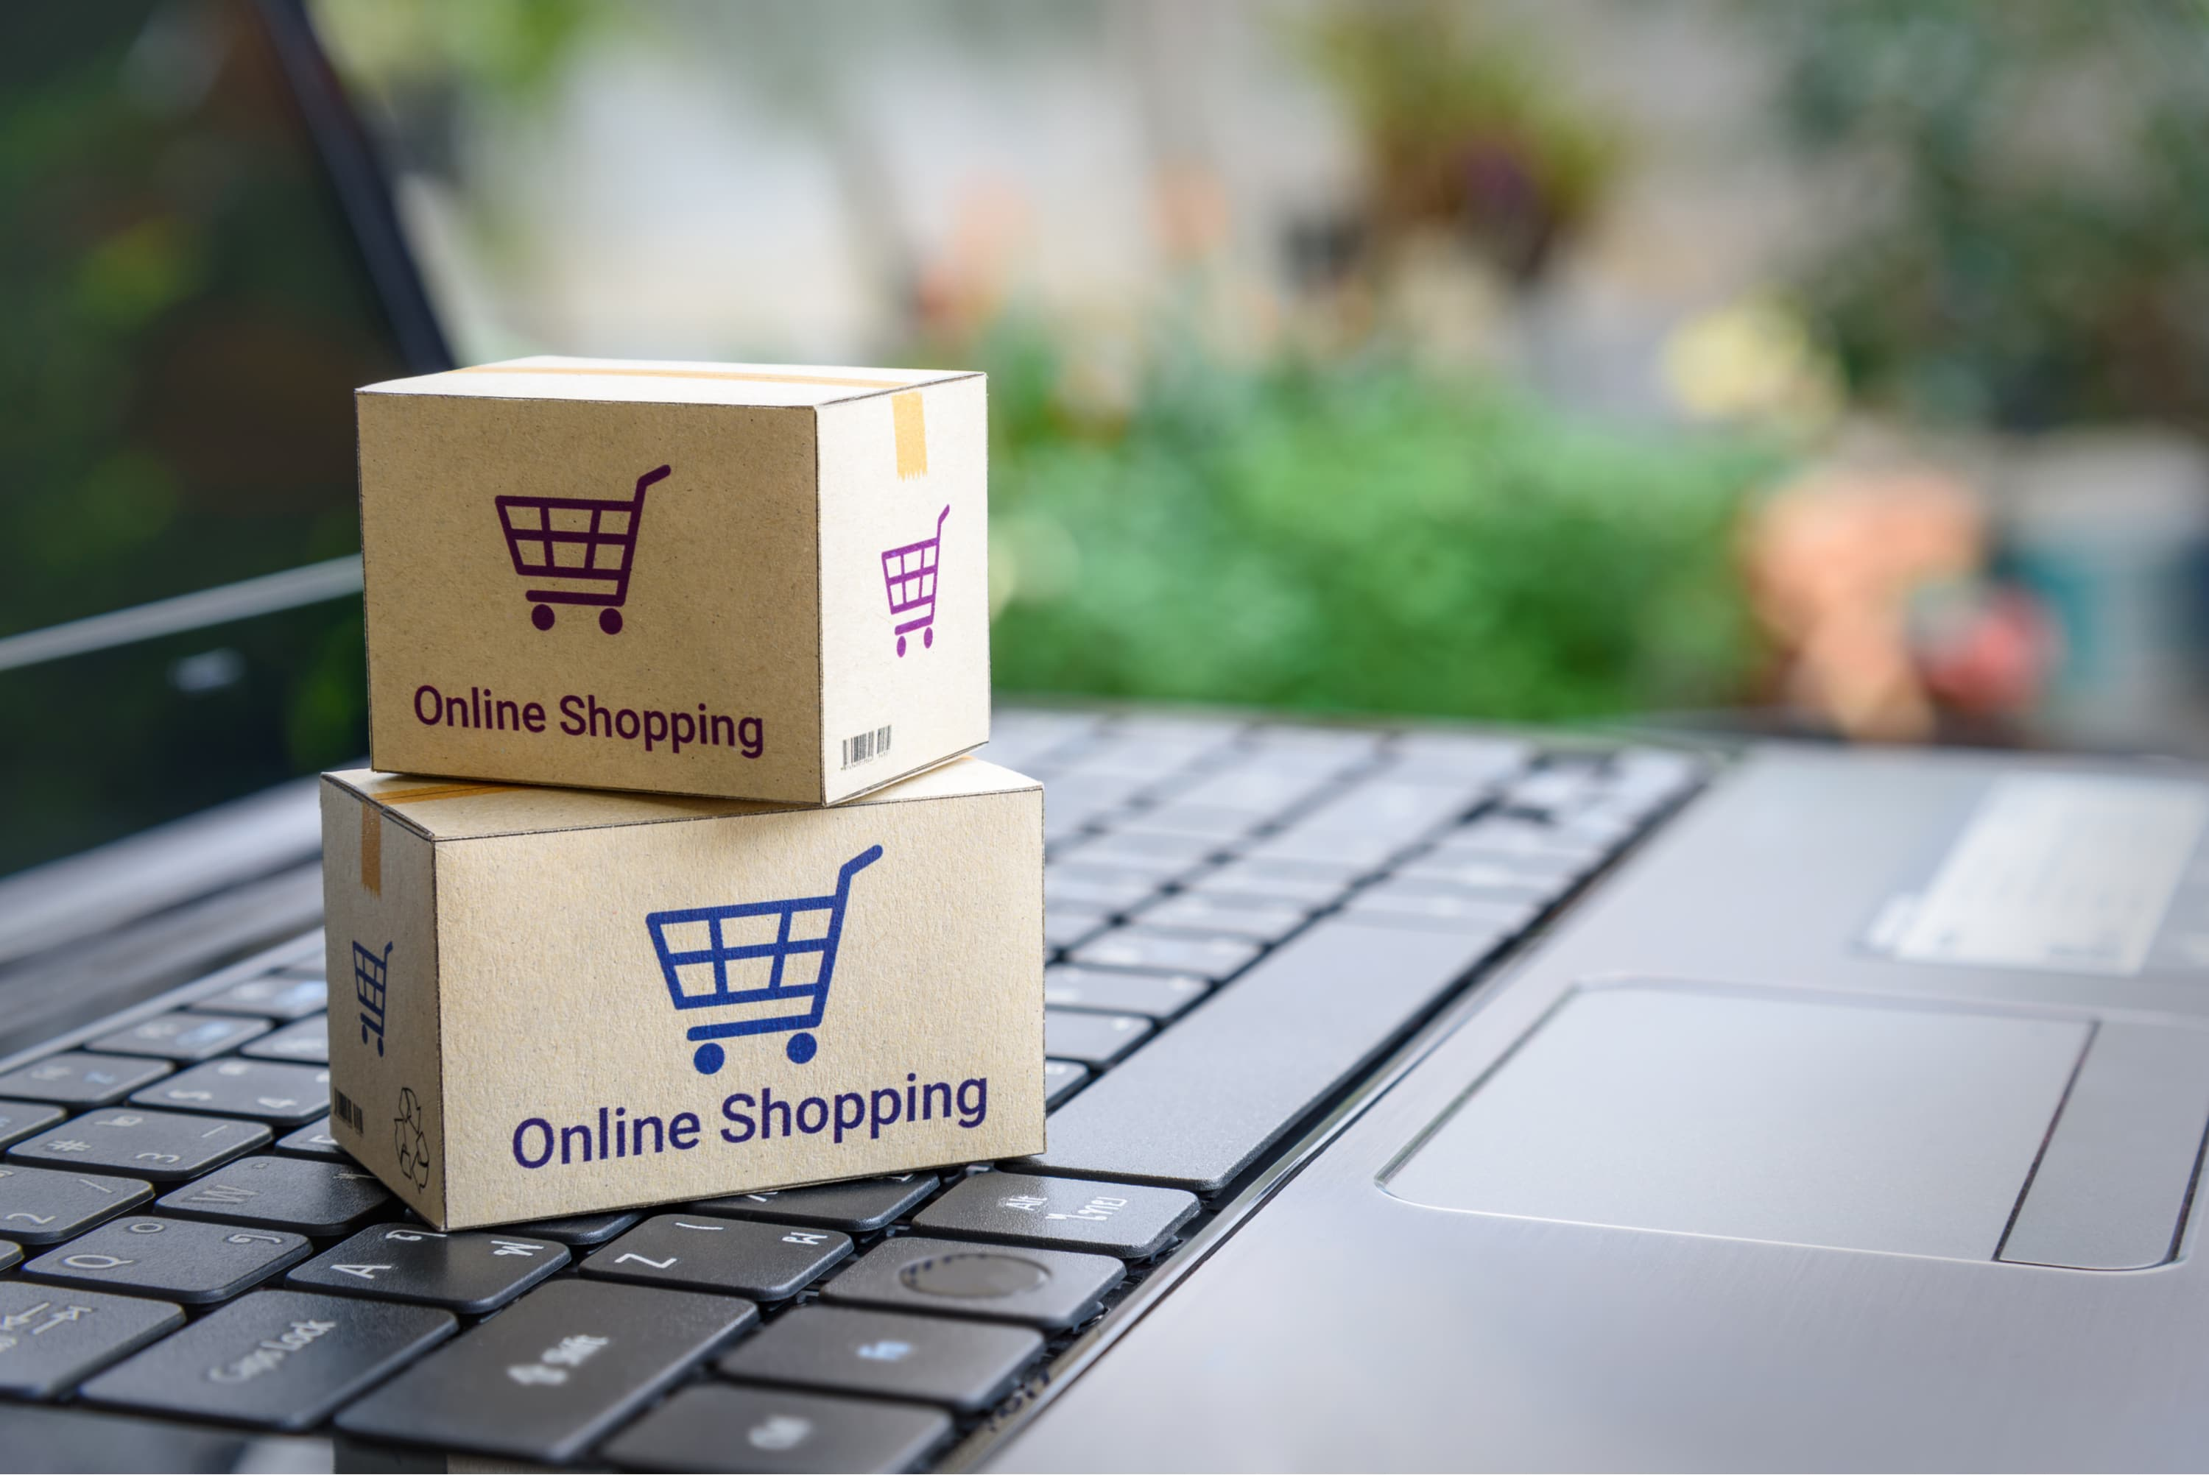
Market Basket Analysis
Capstone Project
Richard Jose 0822435
Sandeep 0824176

Slide 2
Market Basket Analysis
Market Basket Analysis is a popular example of frequent itemset mining technique. This process identifies customer buying habits by finding associations between the different items that customers place in their shopping baskets. The discovery of this kind of association will be helpful for retailers or marketers to develop marketing strategies by gaining insight into which items are frequently bought together by customers, whether from a grocery store or online retail.

Slide 3
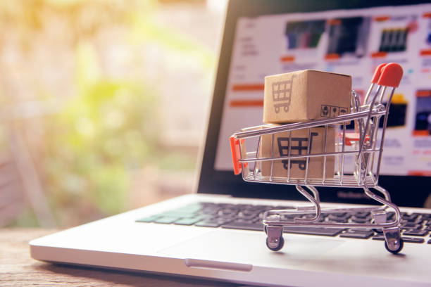
Introduction
K&M Superstore is Online franchise Superstore that sells different types of products worldwide. Its first and main branch is located in the UK and there are several other branches worldwide. There are different kinds of products and their varieties sold in these superstores.

Slide 4
Dataset
The Online Retail dataset, available from the UCI Machine Learning Repository, contains transactional data from an online retailer. The dataset covers transactions made between 01/12/2010 and 09/12/2011. It includes approximately 541,909 transactions.
Attributes:
Invoice No: A unique identifier for each transaction.
Stock Code: A unique identifier for each product.
Description: A brief description of the product.
Quantity: The quantity of items purchased in each transaction.
Invoice Date: The date and time of the transaction.
Unit Price: The price of a single item in British pounds.
Customer: A unique identifier for each customer.
Country: The country where the customer resides.

Slide 5

Tools To be Used In the Project
Excel (Data Understanding)
SQL (Data Cleaning & Data Preprocessing)
Python(Data Analysis)
Power BI (Data Visualization)

Slide 6
BUSINESS Problems
Analyze the transaction data of sales orders from more than 541,909 transactions(Perform EDA Analysis).
Products that have highest and lowest sales?
Countries with highest sales?
What are the most frequently purchased items?
What are the relationships between different products in terms of co-occurrence?
What products are commonly bought together?
Are there any specific item combinations that lead to higher sales or customer satisfaction?

Slide 7
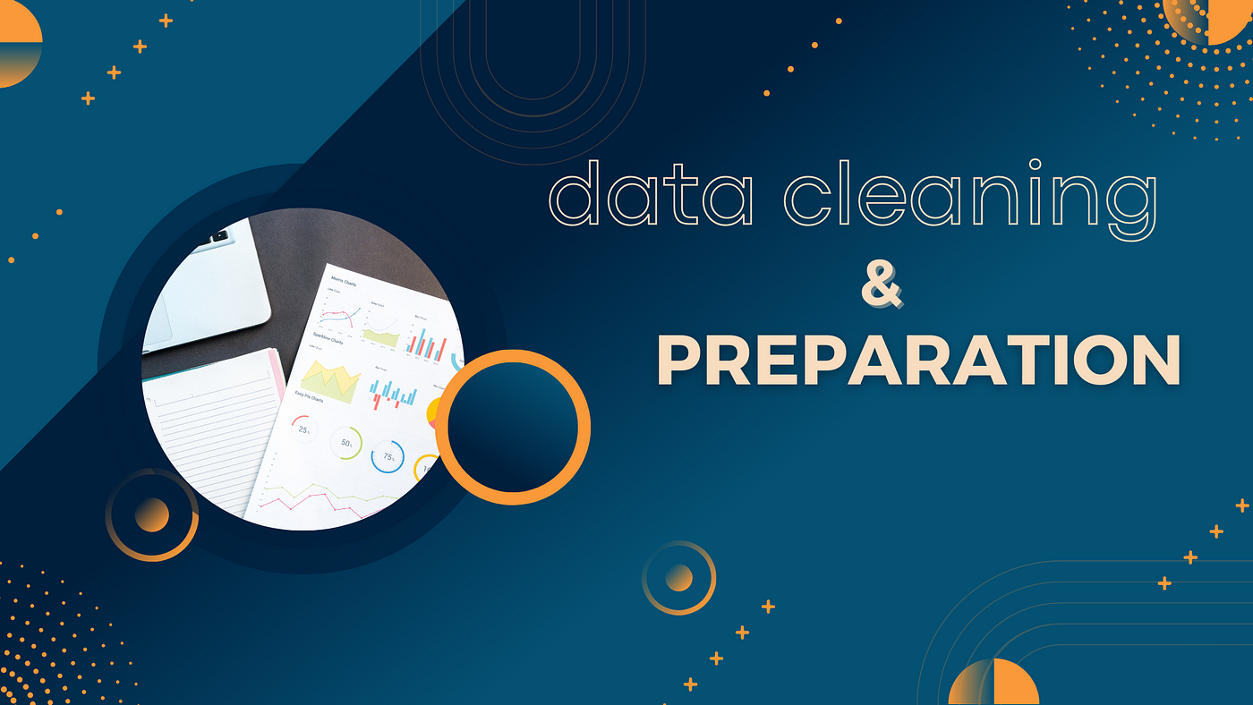

Slide 8

For Data Cleaning and Data Preprocessing we used the Software tool Microsoft SQL Server. After importing the raw dataset in the SQL Server, We performed the following steps to Clean the dataset and do the Preprocessing steps
Removed Null Values that were present in the dataset
Updated the [Description] Column in the dataset so that it doesn’t have any extra spaces in the left side its content using LTRIM function.
Updated the [Description] Column in the dataset so that it doesn’t have any extra spaces in the right side its content using RTRIM function.
Updated the datatype of [InvoiceNo] Column to String Datatype.
Removed the Records that Contained ‘POSTAGE’ in the [Description] Column.
Separating the DateTime Column And Creating New the [Invoice_Date] and [Invoice_Time] Columns in the [Transcations_Records] Table.
Deleted the Records that has negative values in the [Quantity] Column.

Slide 9
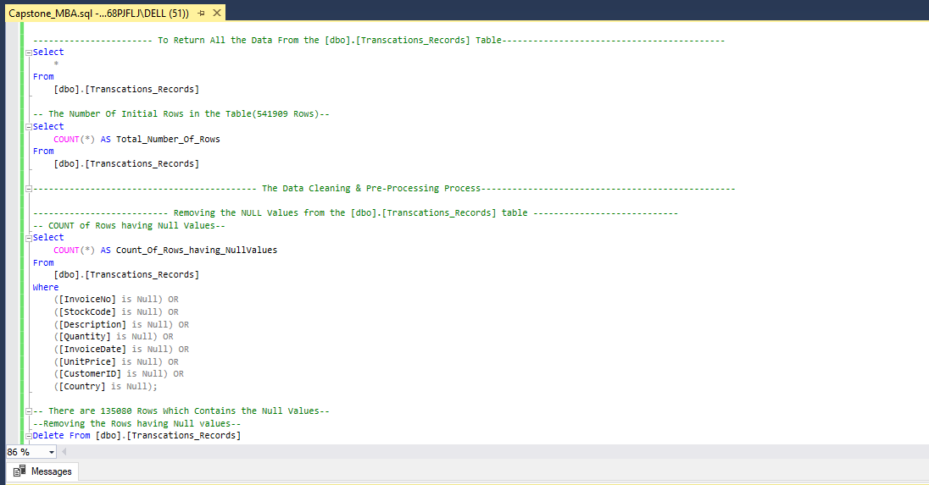

Slide 10
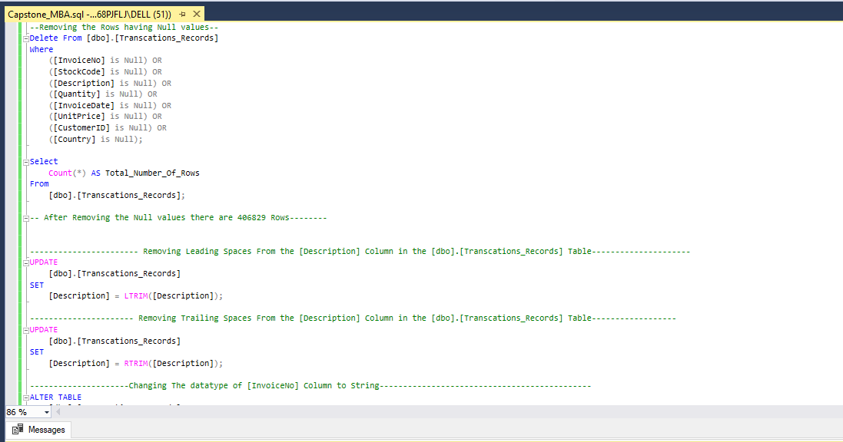

Slide 11
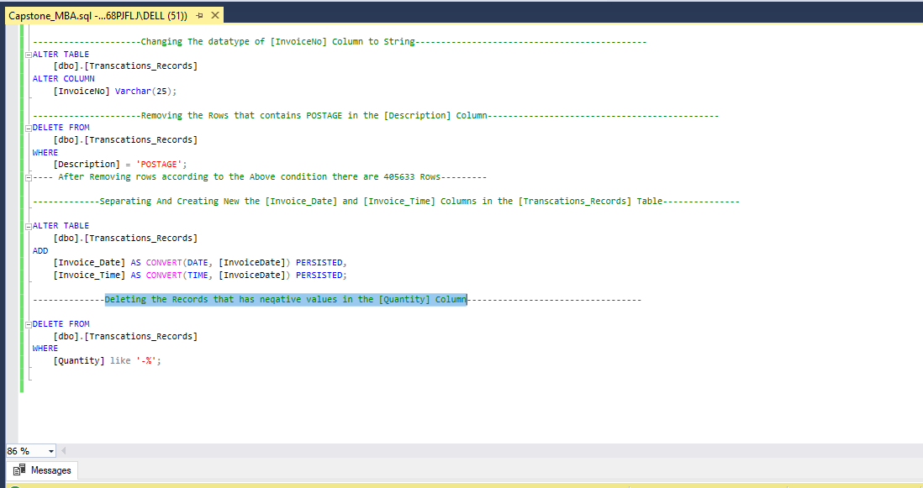

Slide 12

DATA ANALYSIS

Slide 13

After Data Cleaning and Data Preprocessing comes the next step Data Analysis, And for Data Analysis We used the Software tool Jupyter Notebook for using the Python Code for Analysis.
For the initial stages of the Analysis, We imported the necessary packages in the Jupyter notebook like:
Numpy
Pandas
Seaborn
Matplotlib
Apriori [mlxtend.frequent_patterns]
Association_rules [mlxtend.frequent_patterns]
After Importing the necessary packages, we imported the cleaned and Preprocessed dataset into the Jupyter notebook
After importing the dataset, We did basic initial analysis like Displaying the dataset, Size of the data, Checking for null values, reviewing the datatypes.

Slide 14
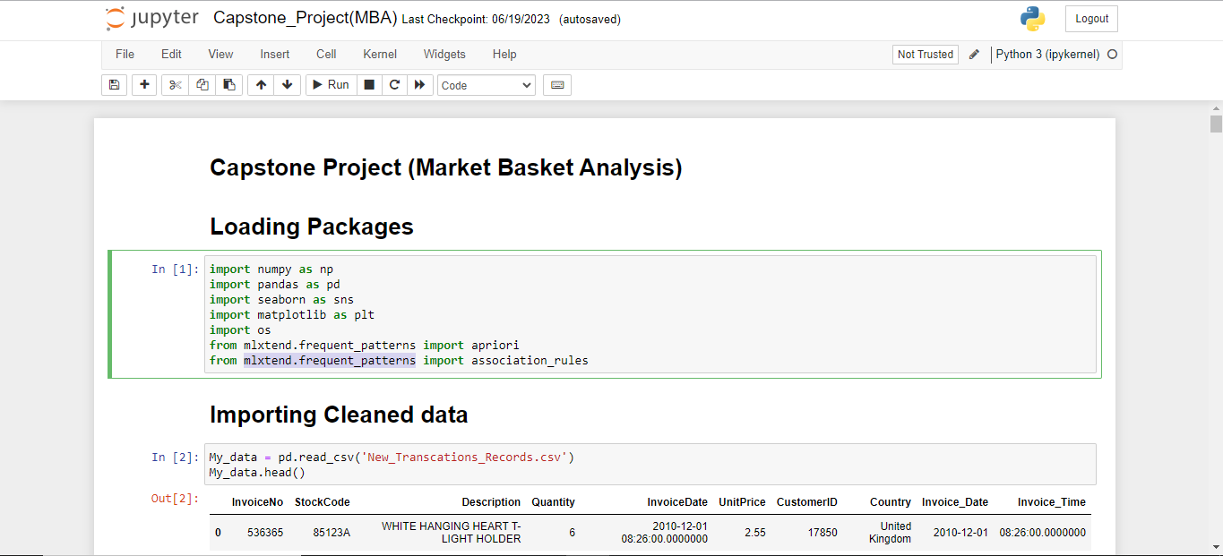

Slide 15
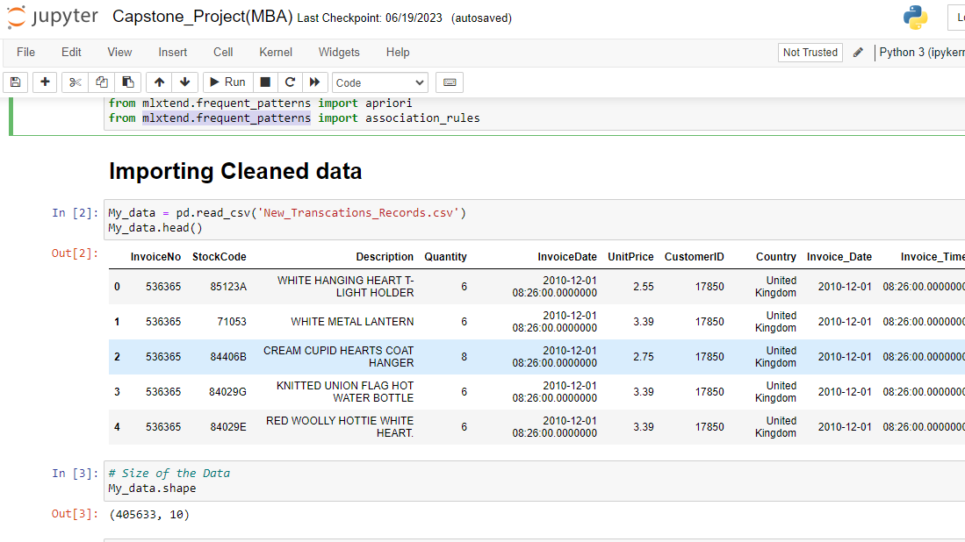

Slide 16
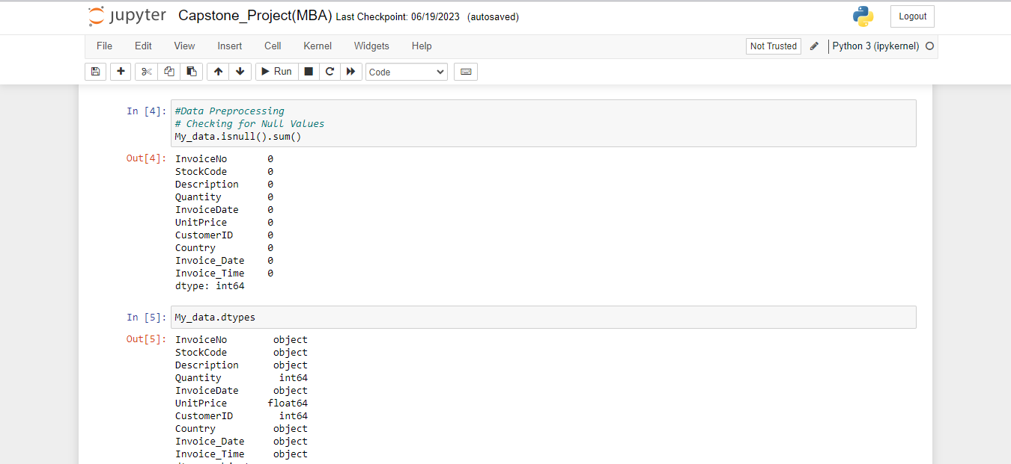

Slide 17
Exploratory Data Analysis (EDA)
In data analytics, Exploratory Data Analysis is how we describe the practice of investigating a dataset and summarizing its main features. It is a form of descriptive analytics.
EDA aims to spot patterns and trends, to identify anomalies, and to test early hypotheses.
The Steps that we used in the EDA analysis are:
Checked the number of Transactions recorded as per each country.
Total Number of Countries.
Analyzing the Sales Performance of the Company
Creating [Total_Amount] Cloumn by multiplying [Quantity] Column and [UnitPrice] Column.
Reviewing the Total Revenue of the Company as per Countries By Grouping the transactions of each countries.
Returning the Top 5 Countries which the Company have Highest Sales.
Returning the Bottom 5 Countries which the Company have Lowest Sales.

Slide 18
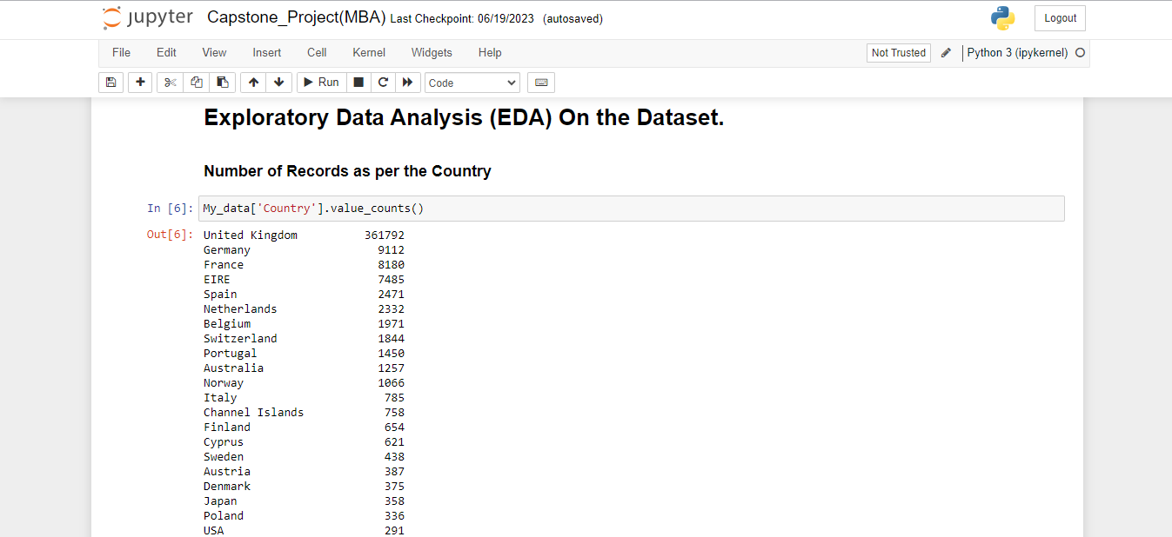

Slide 19
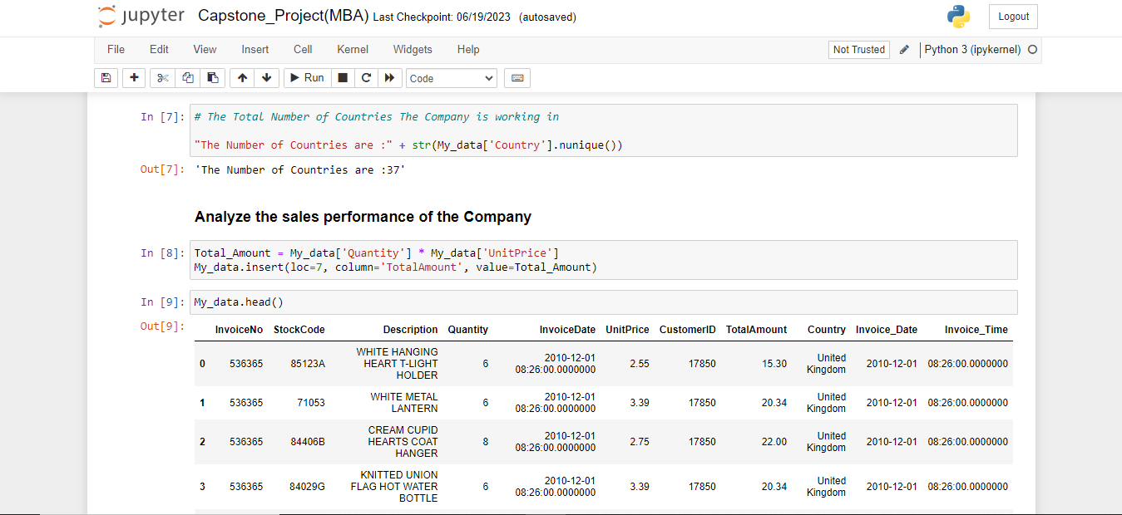

Slide 20
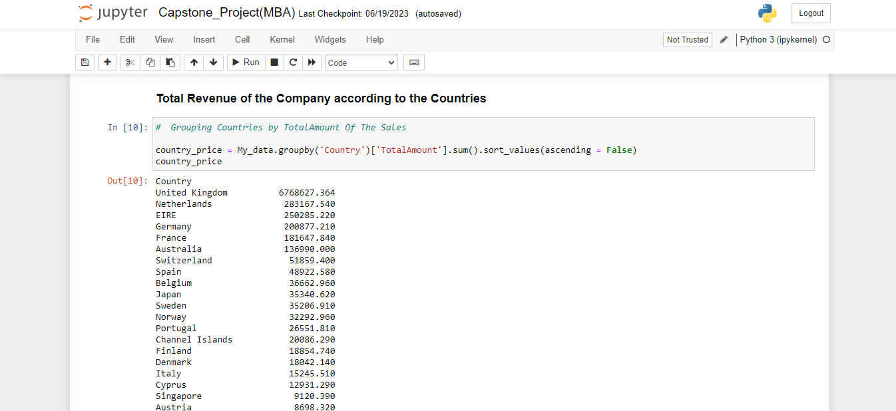

Slide 21
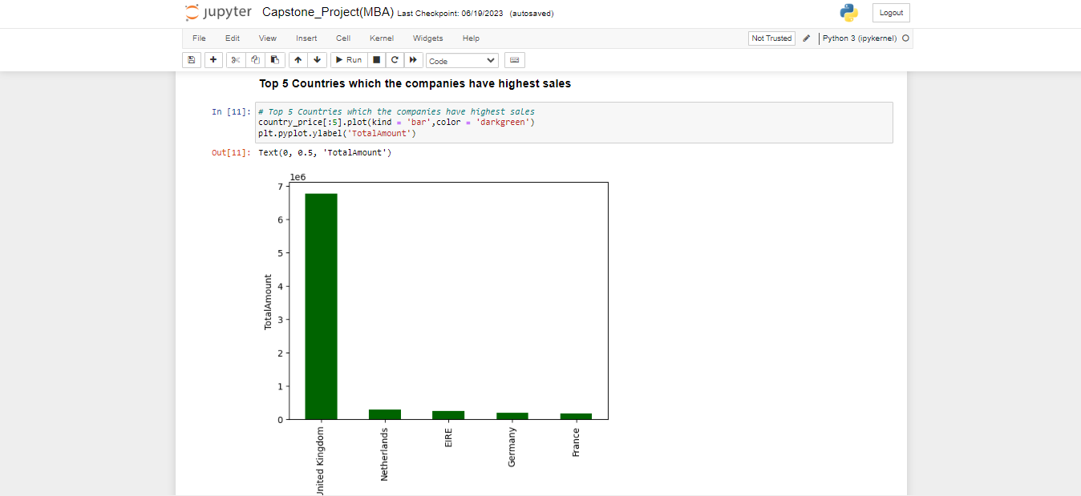

Slide 22
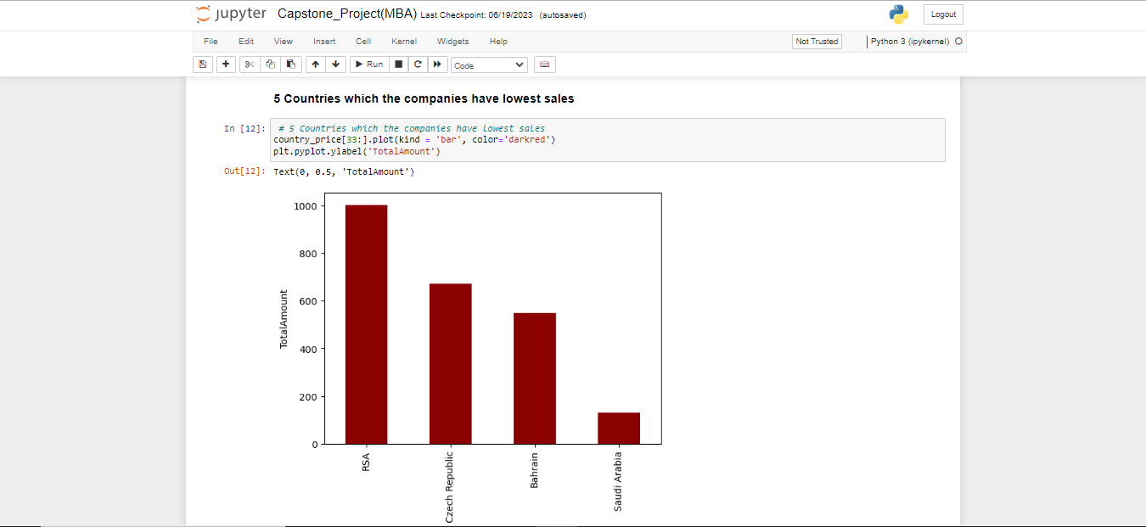

Slide 23
Analyzing the Low Revenue of the company
Now the Question arises that why do these countries have lowest sales?, And to look into that we started analyzing the customers of the company and their count as per the countries
To analyze the customers, we used these steps in the EDA Analysis:
Analyzing the Countries with least Customers of the Company.
Analyzing the Countries with highest Customers of the Company.
Analyzing the Revenue of the Company with respect to year and month.
Analyzing the Revenue of the Company with respect to the Year 2010 and Year 2011
Analyzing the Revenue of the Company with respect to the months.
Analyzing the Revenue of the Company and the Quantity of the products sold with respect to each Products in the dataset.

Slide 24
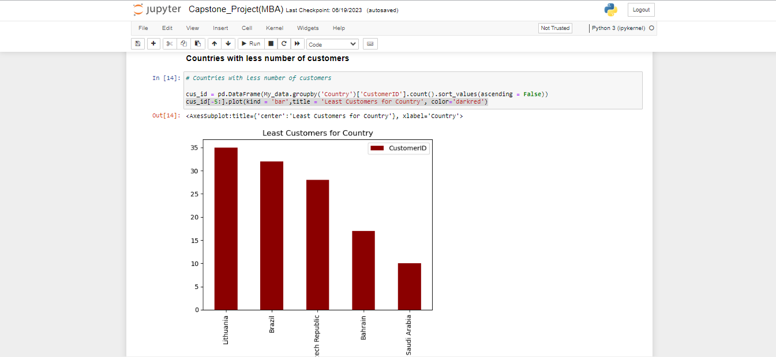

Slide 25
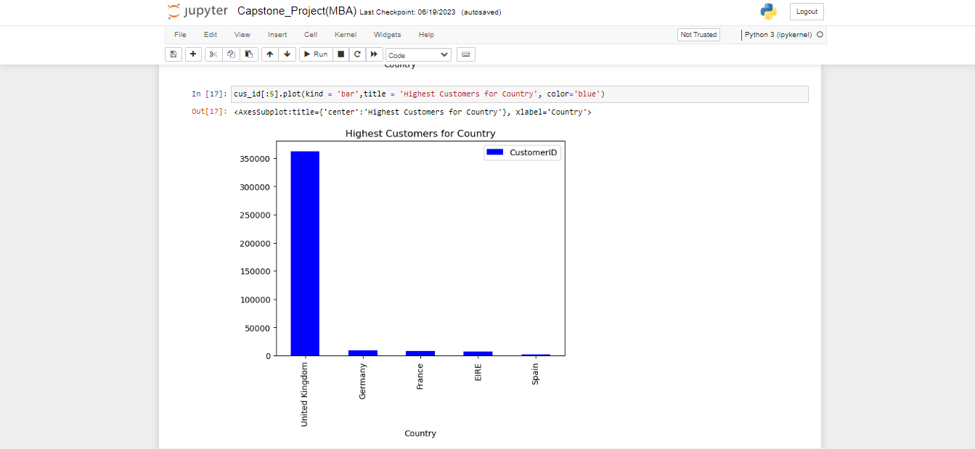

Slide 26
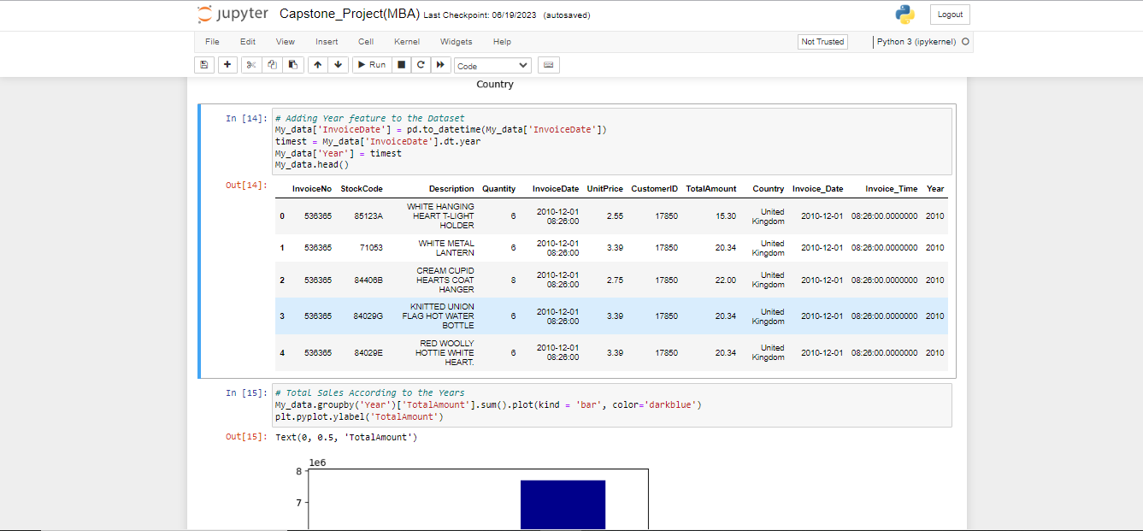

Slide 27
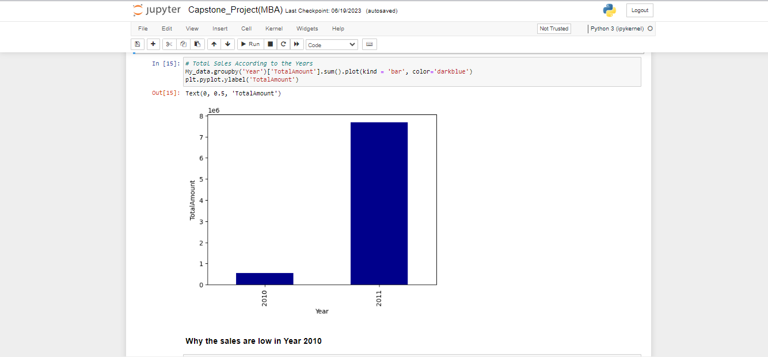

Slide 28
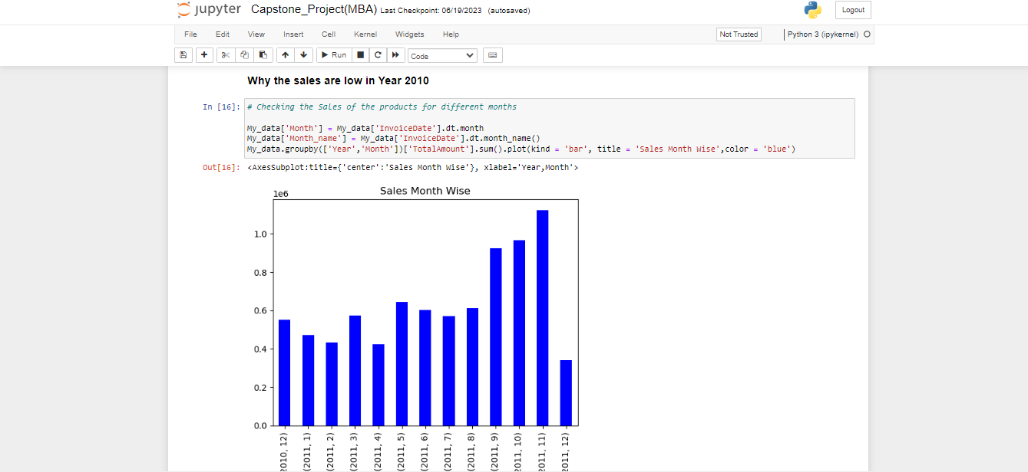

Slide 29
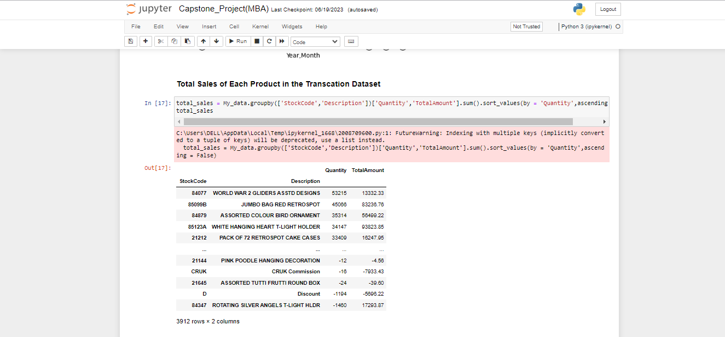

Slide 30
Market Basket Analysis
Market basket analysis is a data mining technique that looks for relationships between items that customers frequently buy together or place in the same basket. It helps analysts understand customer purchase behaviors and predict what new customers may purchase.
The packages that are used for the Market Basket Analysis are:
Apriori [mlxtend.frequent_patterns]
Association_rules [mlxtend.frequent_patterns]
The Steps involved in the Market Basket Analysis are:
Make a Transaction order Basket with respect to the [InvoiceNo] Column, using the [InvoiceNo],[Description] and [Quantity] column of the dataset.
Converting all the positive values in the new basket dataset to 1 and everything else to 0
Creating the new Basket dataset containing values of 0s and 1s.

Slide 31
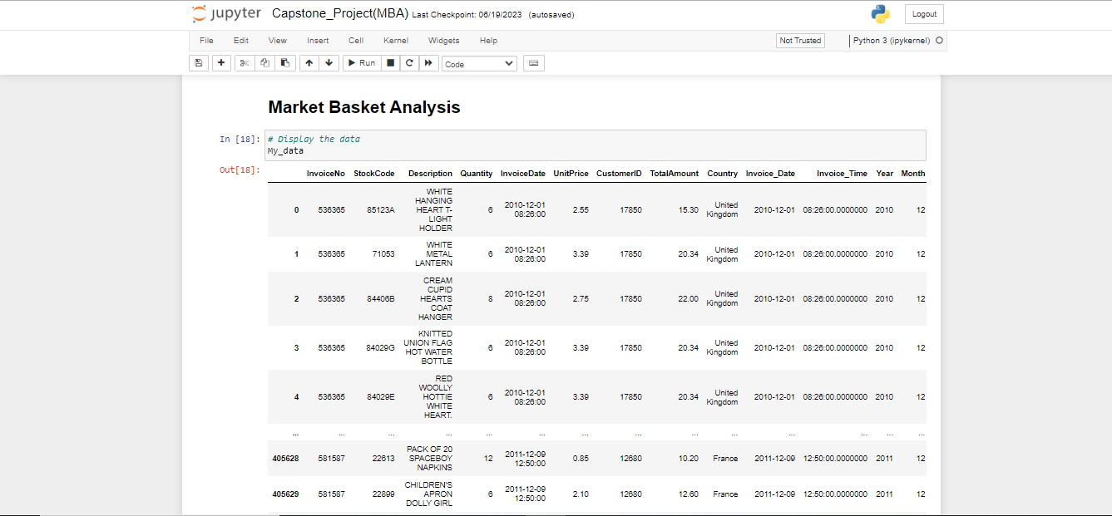

Slide 32
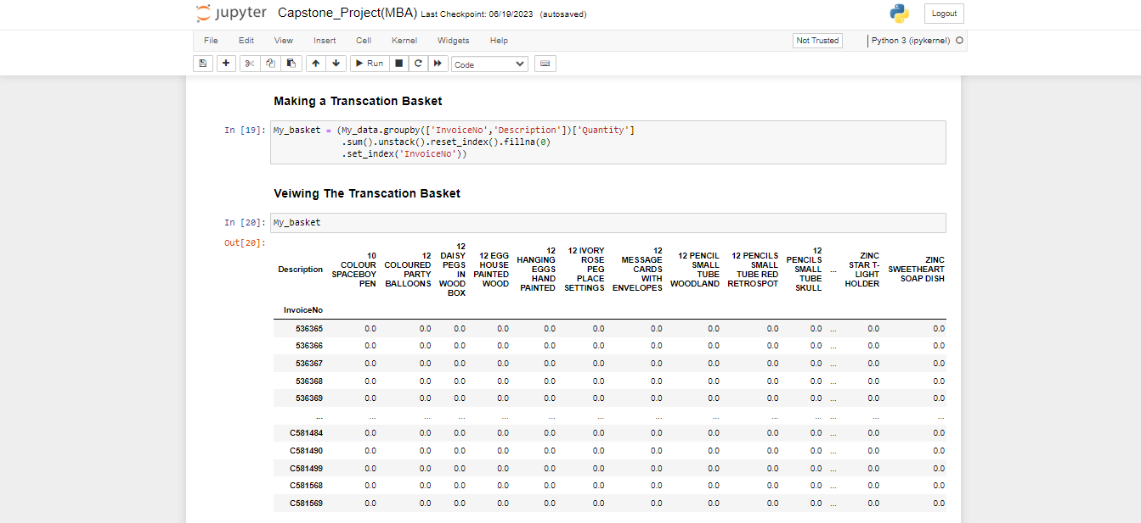

Slide 33
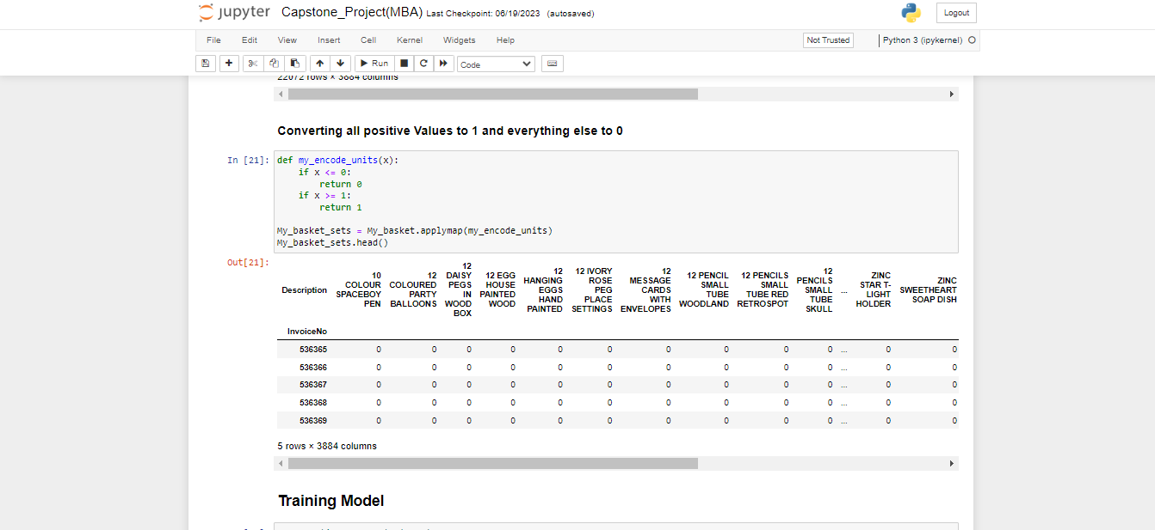

Slide 34
Training The model
Training the dataset model for Market basket analysis is done by the package Apriori algorithm and the association Rules package.
The Components in the algorithm that are used to train the dataset model are:
Support
Confidence
Lift
The steps involved during training the model are:
Generating frequent Items using apriori algoritm by providing min-support values.
Giving Rules, threshold and metric values using the association rules package and generating optimum rules.
Reviewing the Frequency of the Products and their associated products.
Filtering the Association rules between the products with optimal LIFT values and CONFIDENCE values.
Finally, the model returns SUPPORT, CONFIDENCE and LIFT values of the products and their associated products.

Slide 35
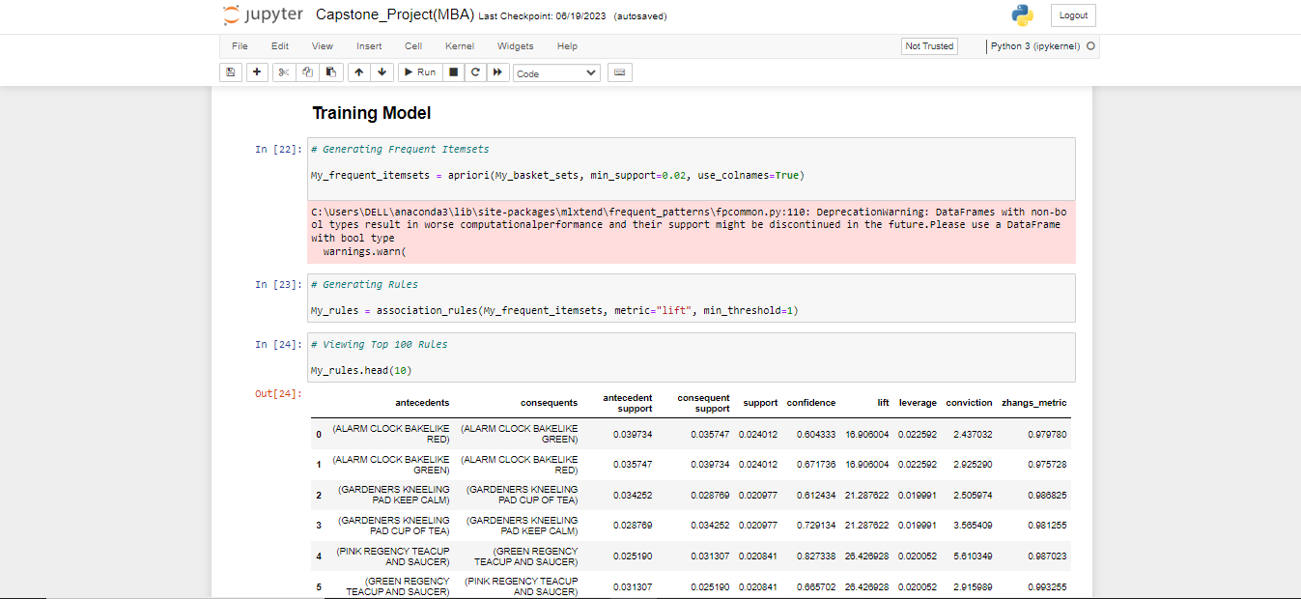

Slide 36
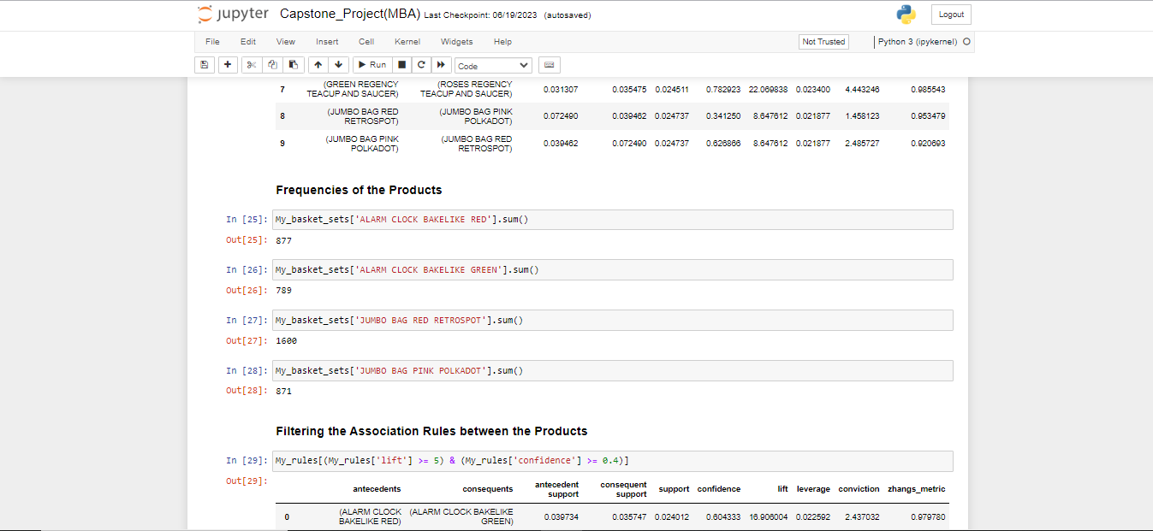

Slide 37
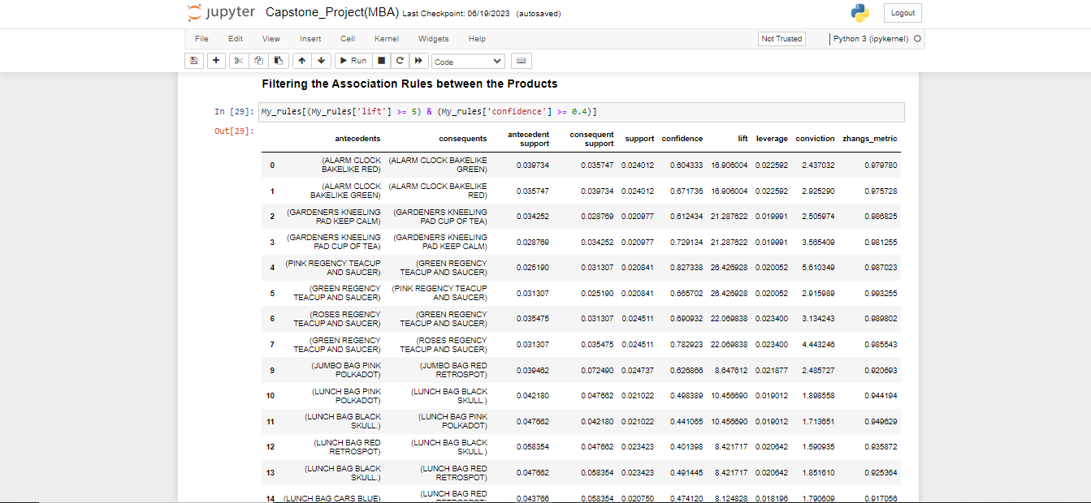

Slide 38
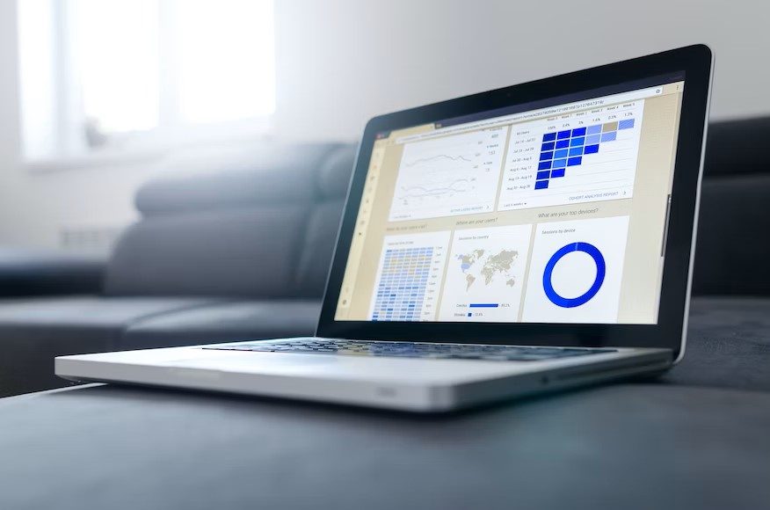
DATA Visualization

Slide 39

After Data Cleaning and Data Analysis comes the final part the Data Visualization. And for Data Visualization we used the software tool Power BI.
In Power BI we created 3 Dashboards for 3 Different Analysis and there are:
Revenue Analysis
Customer Analysis
Market Basket Analysis
The steps used to make the visuals in the Power BI:
Filters were used for the visuals.
Filters were used in the Market Basket Page, Revenue ` Page, Customer Page
Measures were used for the visuals.
Measures were used in the Market Basket Page
DAX Query were used for the visuals.
Dax Query was used in the Market Basket Page

Slide 40
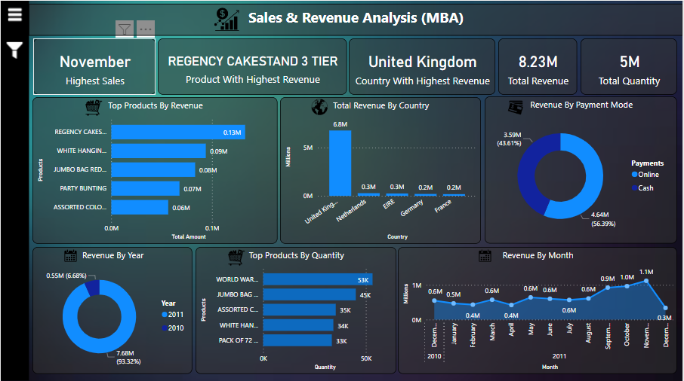

Slide 41
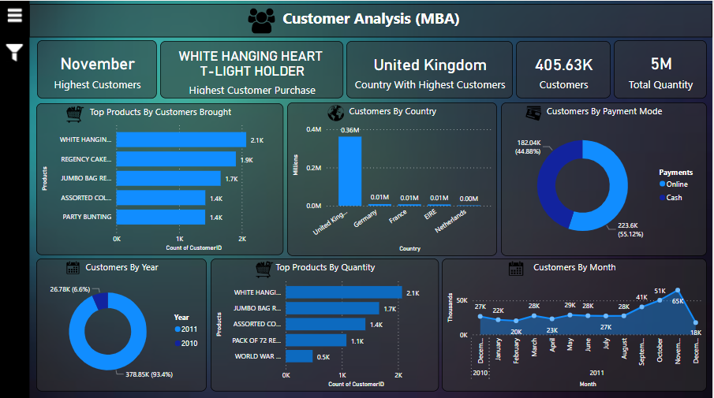

Slide 42
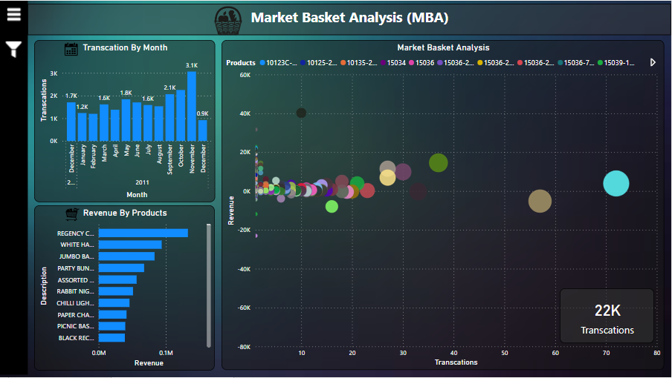

Slide 43
THANK YOU

Slide 44
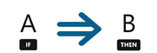
MARKET Basket Analysis
It is an analyzing technique based on the idea that if we buy an item then we are bound to buy or not-buy a group (or single) items. For example, if a customer is buying bread, then the chances of him/her buying jam is more. This is represented by the following equation:
Association Mining Rule
This equation is called the Association Mining Rule. This can be thought of as an IF-THEN relationship. If item A is bought by a customer, then the chances of item B being bought by the same user in the same transaction is found out. Here A is called the Antecedent and B the consequent. Antecedents are primary item that are found in the basket and consequents are the items that are found with an antecedent/group of antecedents

Slide 45
Apriori Algorithm

Slide 46
Apriori Algorithm
The Apriori algorithm is the most common technique for performing market basket analysis.
It is used for association rule mining, which is a rule-based process used to identify correlations between items purchased by users.
Most store customers have purchased popcorn, milk, and cereal together. Therefore, {popcorn, milk, cereal} is a frequent itemset as it appears in most purchases. So, if a person grabs popcorn and milk, they will also be recommended cereal.
According to the Apriori algorithm, a subset of the frequent itemset is also frequent. Since {popcorn, milk, cereal} is a frequent itemset, this means that {popcorn, milk}, {popcorn, cereal}, and {milk, cereal} are also frequent. Due to this, if a customer only goes for popcorn, they will be recommended both milk and cereal as well.

Slide 47
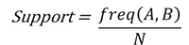
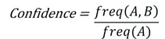
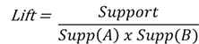
the Components of the Apriori Algorithm are:
Support
Confidence
Lift
It indicates the strength of a rule over the randomness of A and B being bought together. It basically measures the strength of any association rule(we will talk about association rules below).
More the lift more is the strength of the rule. If the lift is 3 for A -> B then it means if we buy A, the chances of buying B is 3 times.
It tells us about the combination of items bought together frequently. It gives the part of transactions that contain both A and B.
We can filter out the less frequently occurring items-sets using support.
It tells us how frequently the items A and B are bought together, for the no. of times A is bought.

Slide 48
THANK YOU

